Slide 1
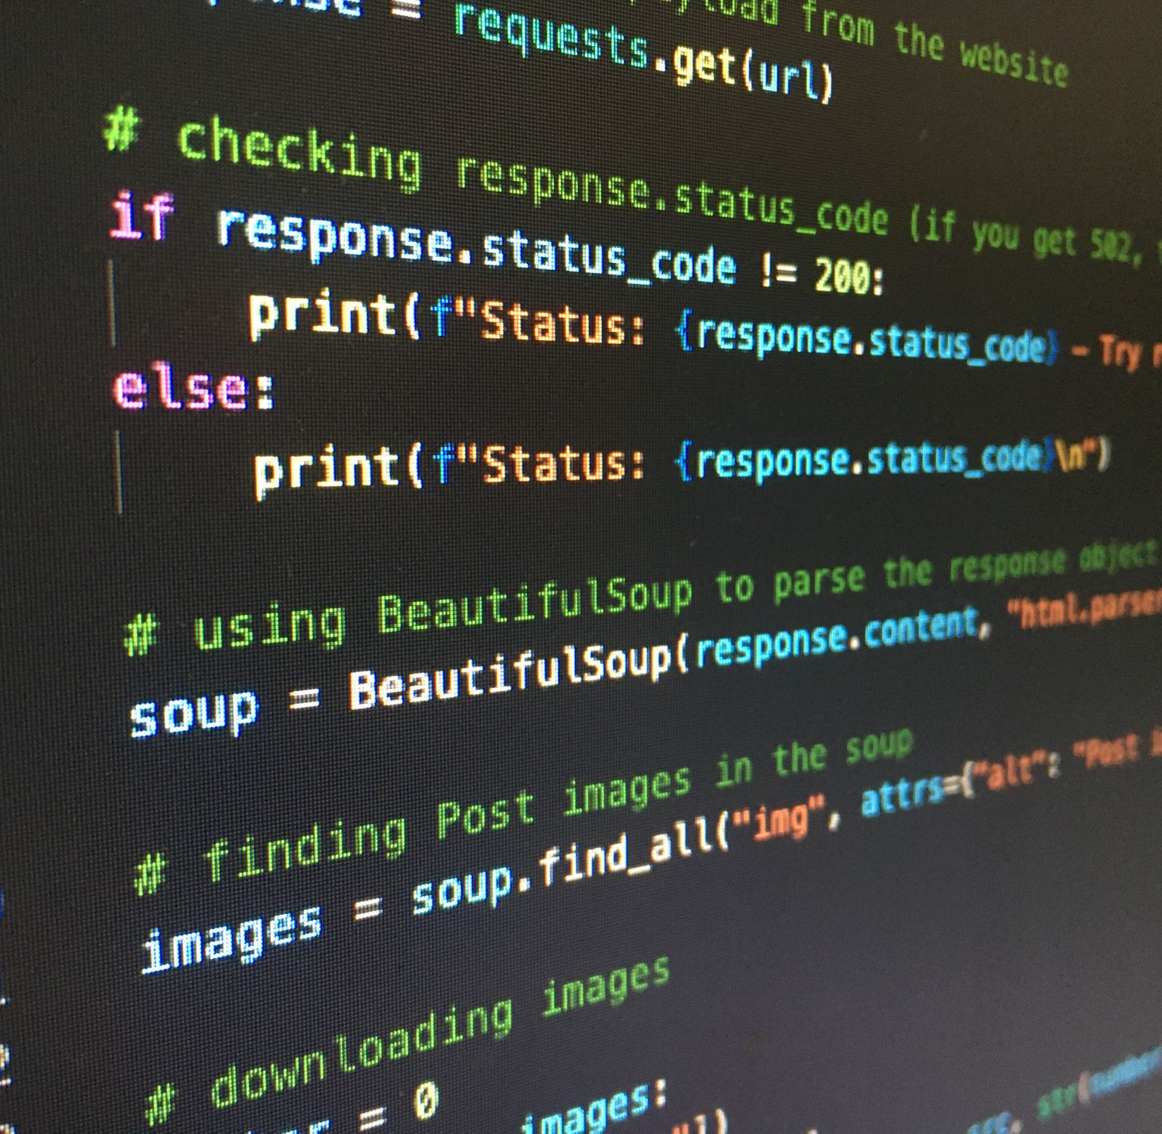
Ψ
Advanced Python for Psychologists
Dominique Makowski – July 2022
Prerequisites
Create a GitHub account
(Install git -> https://git-scm.com/download)

Slide 2

About this workshop
Flexible content: should be useful to you
Flexible schedule: Real-time feedback (pace, pauses, issues…)
Interactive: Programming is learnt by goal-directed trials & errors
dom.makowski@gmail.com (twitter @Dom_Makowski 🐦)
https://github.com/DominiqueMakowski/teaching/
Why Python?
Why not SPSS? Matlab? R?
Free (independence), Powerful (mature), Beginner-friendly (kinda), Versatile (machine learning, stats, signal processing, experiments…), Demanded (💰)
My own journey with Python
TO TELL ME WHAT YOU NEED

Slide 3

What do you do?
What’s your experience & need with Python?

Slide 4

Advanced Python
Personal coding vs. re-usable coding
Modularity
Functions
Availability
Open-sourcing, contributing
Re-usability
Packaging
Efficiency
Vectorization, profiling, …
Advanced != Expert knowledge
Generalizability
Beginner Pythonista
Expert Pythonista

Slide 5
Program (theoretical)
9am – 2pm (break time? 15 min 10h30 + 45min at 12h?)
Day 1: Python basics
Morning
Setting-up Python, VS-code
Python basics
Afternoon
Installing packages
Numpy, scipy & pandas
Day2: Advanced
Morning
NeuroKit & Signal Processing Basics
Afternoon
Packaging
Docstrings
Day 3: Reproducibility and Packaging
Morning
Posting package on GitHub
Afternoon
On-demand
Homework: Create your own accessible and documented Python package to reproduce the creation of descriptive statistics of heart rate (Mean, SD, etc.) given a file containing an ECG signal
Goal:
Installation instructions work (I can install)
Documentation website contains examples that I can run locally
The functions are documented
Bonus:
You leave one typo that you reference in an issue
Make a Pull Request on a classmate’s package to address that issue

Slide 6
Basic Python

Slide 7
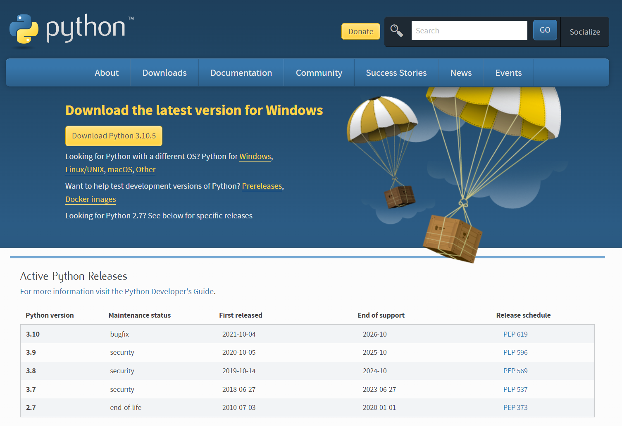
Setting-up Python
Python
Installation
python.org/downloads
Download Python 3 (= 3.x)
Install it

Slide 8
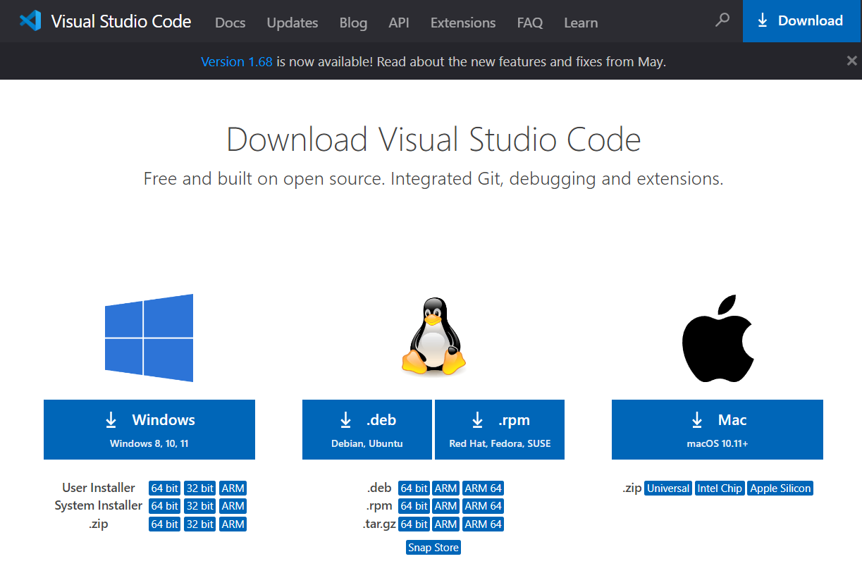
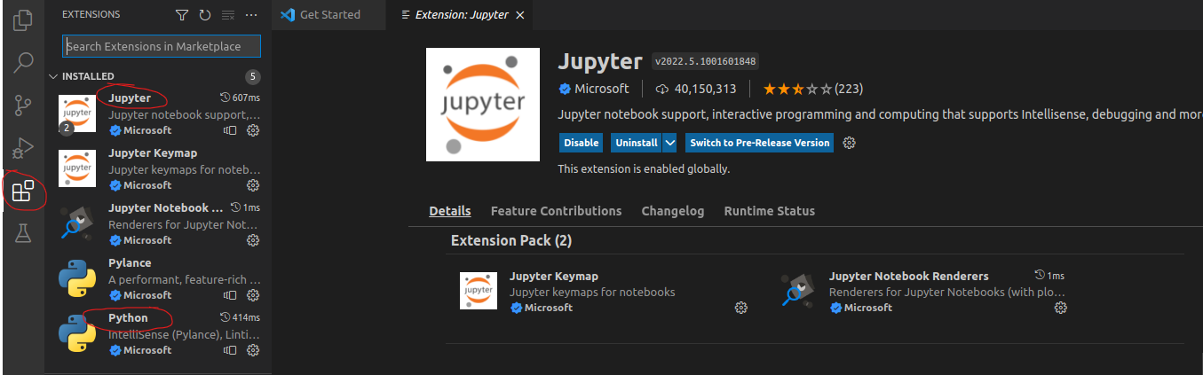
Setting-up Python
VS CODE
Still painful and clunky, but becoming the default 🤷
Installation
Download VS Code
code.visualstudio.com/download
Install it
Extensions
Open, select theme and mark the rest as done
Go to “Extensions”
Install Python & Jupyter

Slide 9
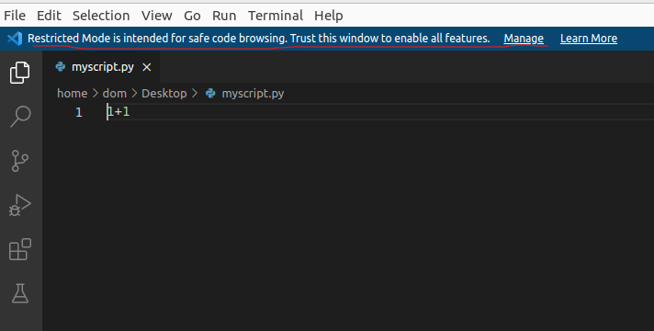
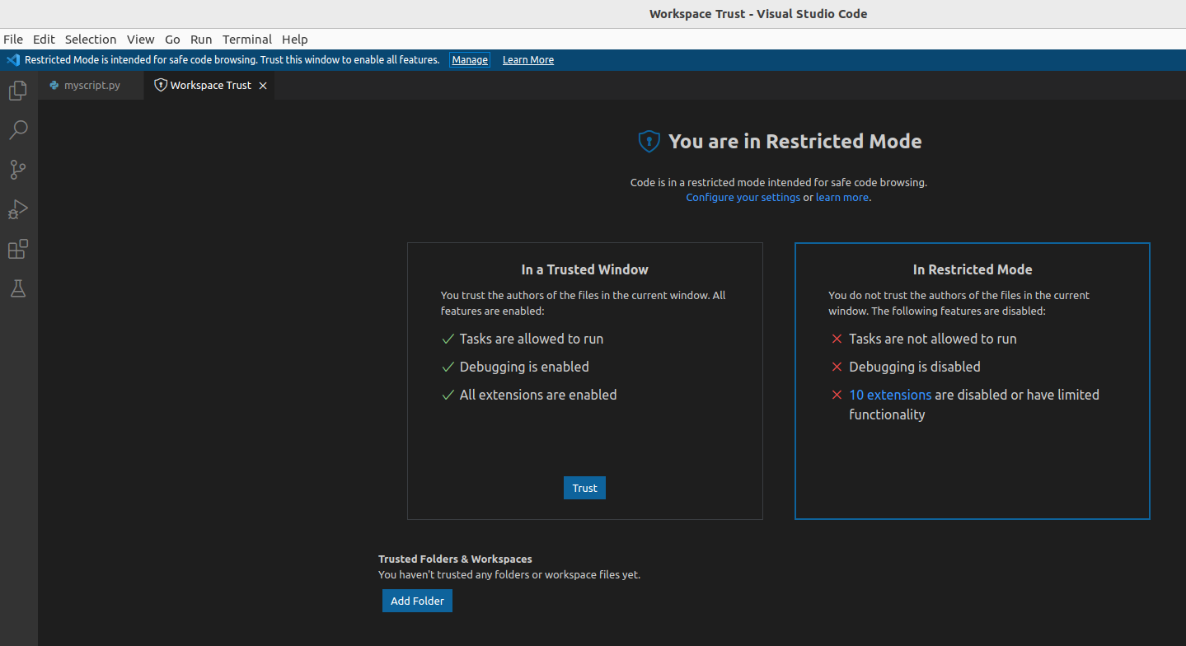
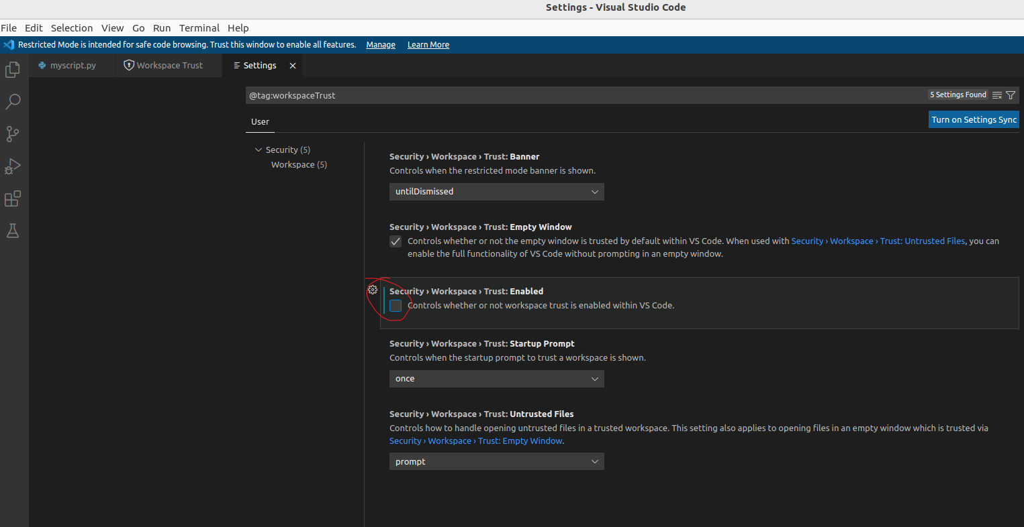
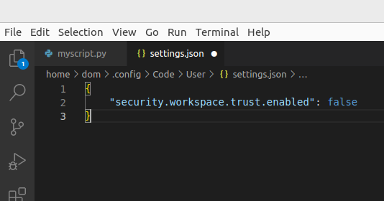
Setting-up Python
Create your first script
From VScode
New file -> Python File -> Save it somewhere (myscript.py)
Edit first settings in VScode
Disable “Trust mode” on Vscode if need be
Manage
Configure your settings
Untick Trust: Enabled
Restart
See the change in settings
View -> Command Palette -> “Settings”
Open Settings (JSON)
Settings in VSCode are just a file! Can be shared, copy-pasted, etc.

Slide 10
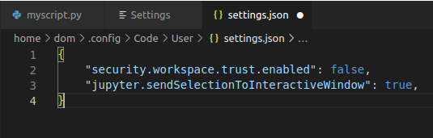
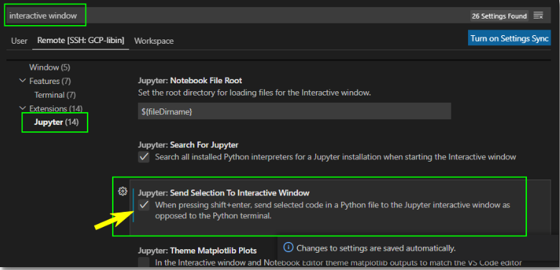
Setting-up Python
Interactive Mode
Directly add “Interactive Python”
“python.dataScience.sendSelectionToInteractiveWindow": true
“jupyter.sendSelectionToInteractiveWindow": true
Case sensitive (camelCase)
Don’t forget commas!

Slide 11
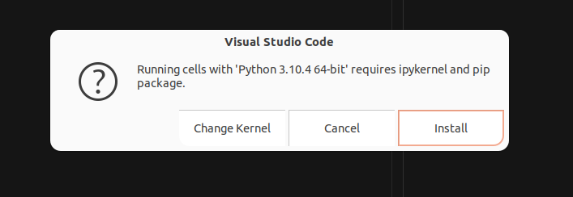
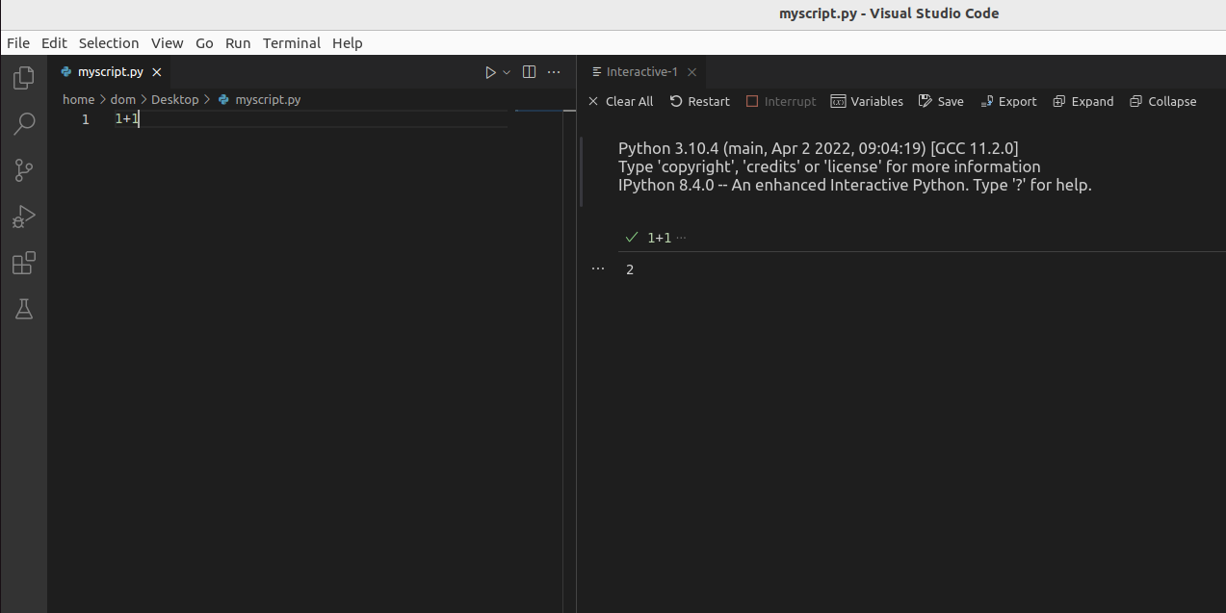
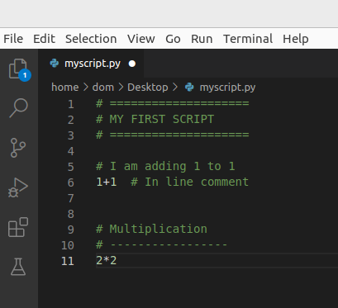
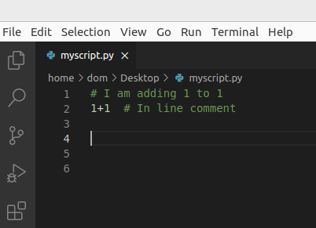
Setting-up Python
Interactive Mode
Go back to your script
Type “1+1”
Select the line
Press SHIFT + ENTER
If prompted install ipykernel / pip
(if nothing happens and it says that pip is not available, let me know!)
Difference script / “console”
Comments !!!
# + 1 space
# + 2 spaces if in-line
Great way to structure and document your code
Syntax & style matters!

Slide 12
Exercice time 💪 (1 min)
Goal: what does “**” do?
1**2; 3**2; 2**3

Slide 13
Basic Python
Control Flow
If, else (& elif)
Create “blocks”
Must end by “:”
Must be indented by 4 spaces
Operations
+, -, *, **, …
Modulo
Equivalence
Data Types
Operations behave differently on different types (e.g., for numbers, addition; for strings, concatenation)
Booleans (binary)
Numbers
Integers (int())
Floats (float())
Strings
Strings (“…”)
f-string (f“…”)
Check for types: isinstance(3, float)
Variables
myvar = 3

Slide 14
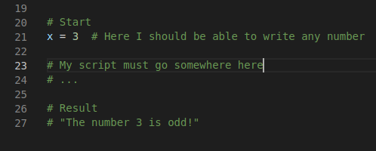
Exercice 1 💪 (5 min)
Goal: write a script that checks if a variable is odd or even
# Start:
x = 3
# Result:
“The number 3 is odd”

Slide 15

Basic GitHub
GitHub
Why? It’s the future.
Super useful for storing projects, data, scripts, & sharing what you want
Became the default repository for neuroscience & psychology
Create your own page: create a new repository called MyName/MyName
Must contain a README.md file is the base component of every repo
This files (and everywhere on GitHub, stackoverflow, …) uses “Markdown” (MD)
*italic*
**bold**
# Title
## Subtitle
### Subtitle
`inline code`
```python
A code chunk
```

Slide 16
Goal: Create your personal GitHub page
Use some Markdown syntax
Post your profile as an answer to the GitHub discussion
Exercice 2 💪 (8 min)

Slide 17
Basic Python
x = “3”
Code can be broken
Advanced Python means building reliable and solid code
Functions
Basis of code modularity
Allows the code to be easily re-usable
A good way to think about the code is to think in terms of functions
A function is created with:
def myfunction(x):
y = x + 1
return y
Minimal function
Arguments
Return object
Indentation!

Slide 18
Goal: Create a function that:
Takes an input
Checks whether an input is odd or even
Returns True/False
Robust (deals with unexpected inputs) (e.g., isinstance(x, str))
Is documented (some comments explain what the code does)
Post your function as an answer to the GitHub discussion
Exercice 3 💪 (10 min)

Slide 19
Basic Python
Lists and Dictionaries
Containers of multiple things
Lists are ordered
Dictionaries contain items that have names (“keys”)
mylist = [1, 2, 3]
mydict = {"A": 1, "B": 2, "C": 3}
Indexing []: an essential skill
mylist[1]
mylist[0:2]
Indexing in Python starts from 0!
mydict[1]
mydict["b"]
mydict["B"]

Slide 20
Without trying, what’s the output of:
mydict = {"1": 0, "2": 42, "x": 7, "11": 6}
x = str(1 + 1)
y = mydict[x]
print(y)
Exercice 4 💪 (1 min)

Slide 21
Basic Python
While Loops
Loop while something is True
x = True
i = 0
while x is True:
if i > 5:
x = False
print(i)
i = i + 1
What should be output?
Possible simplification:
i = 0
while i <= 5:
print(i)
i += 1

Slide 22
Basic Python
For Loops
Allows to iterate over stuff
One (or multiple) variables that change at every loop
mylist = [2, 4, 5]
for myvar in mylist:
print("current value is" + str(myvar))
Is there a way to simplify the string concatenation?
A convenient way of creating a “list”-like object to iterate on is range()
for i in range(10):
print(i)

Slide 23
Exercice 5 💪 (10 min)
Create a function that takes a number as an input, and prints the Fibonacci sequence (0, 1, 1, 2, 3, 5, …) up until that number
Post your solution as a comment to the discussion

Slide 24
Basic Python
Advanced iteration
Get index and content at the same time
enumerate()
mylist = [2, 4, 5]
for i, myvar in enumerate(mylist):
print(f"index {i}: value is {myvar}")
Iterate or Enumerate on dictionaries
dict.keys() or mydict.items()
mydict = {"A": 1, "B": 2, "C": 3}
for k in mydict.keys():
print(k)
for k, item in mydict.items():
print(k)
print(item)

Slide 25
Basic Python
Can also iterate on strings
sentence = "Hello World"
for l in sentence:
print(l)
Add / remove from containers
Lists: mylist.append(what), mylist.insert(where, what)
Dicts: mydict.pop(what), mydict["key"] = x
Methods
Some objects have “methods” (functions attached to them) – notion of “class”
Some functions & methods act “in-place” (no return)
mylist = [1, 2]
mylist = mylist.append(3)
mylist.append(3)
mylist

Slide 26
Basic Python
Strings have methods too (e.g., .replace(), .lower(), …)
sentence = "Hello World"
sentence = sentence.replace("Hello", "Goodbye") # Not in-place
sentence
Other useful methods include .index() for lists
mylist = ["x", "y", "z"]
mylist.index("y")

Slide 27
Exercice 6 💪 (15 min)
Create an encoder that changes each letter of a sentence into the next letter from alphabetical order
Post your solution as a comment to the discussion
Expected:
>>> x = encode(“Hello World”)
>>> print(x)
“ifmmp xpsme”
Hint: your function might include:
alphabet = ["a", "b", "c", "d", "e", "f", "g", "h", "i", "j", "k", "l", "m", "n", "o", "p", "q", "r", "s", "t", "u", "v", "w", "x", "y", "z"]
Notes:
s = "Hello World"
def encoder(sentence):
# Initialize Encoded word
encoded = ""
# Defined alphabet
alphabet = ["a", "b", "c", "d", "e", "f", "g", "h", "i", "j", "k", "l", "m", "n", "o", "p", "q", "r", "s", "t", "u", "v", "w", "x", "y", "z"]
# Make sure it's lowercase
sentence = sentence.lower()
for l in sentence:
if l == " ":
encoded += " "
else:
idx = alphabet.index(l)
encoded += alphabet[idx + 1]
return encoded
encoder(s)

Slide 28
Basic Python
Functions with multiple arguments
Mandatory arguments vs Optional arguments
Keywords arguments (« kwargs »)
def myfunction(arg1, arg2, arg3=True, arg4=5):
…
myfunction(3, 4, arg4=2)

Slide 29
Exercice 7 💪 (10 min)
Add a decoder feature
Post your solution as a comment to the discussion
Expected:
>>> x = decoder(“Hello World”, encode=True)
>>> print(x)
“ifmmp xpsme”
>>> y = decoder(“ifmmp xpsme”)
>>> print(y)
“hello world”

Slide 30
Basic Python
Functions can use other functions
Utility functions that are meant to be “internal” (non- “exposed”)
Convention to start with “_”
_internalfunction(…)

Slide 31
Exercice 8 💪 (10 min)
Split the two parts into two “internal” functions
Expected:
def decoder(sentence, encode=True)
if encode is True:
return _encode(sentence)
else:
return _decode(sentence)
def _encode(sentence):
pass
def _decode(sentence):
pass
(Can catch bugs using if, elif, else)

Slide 32
Basic Python
Import
Loads packages (or scripts) into memory
import this
Packages
Most functionalities comes from packages
Packages need to be “imported” every time
Add “import os”
Function “os.listdir()”
Useful for listing files / participants

Slide 33
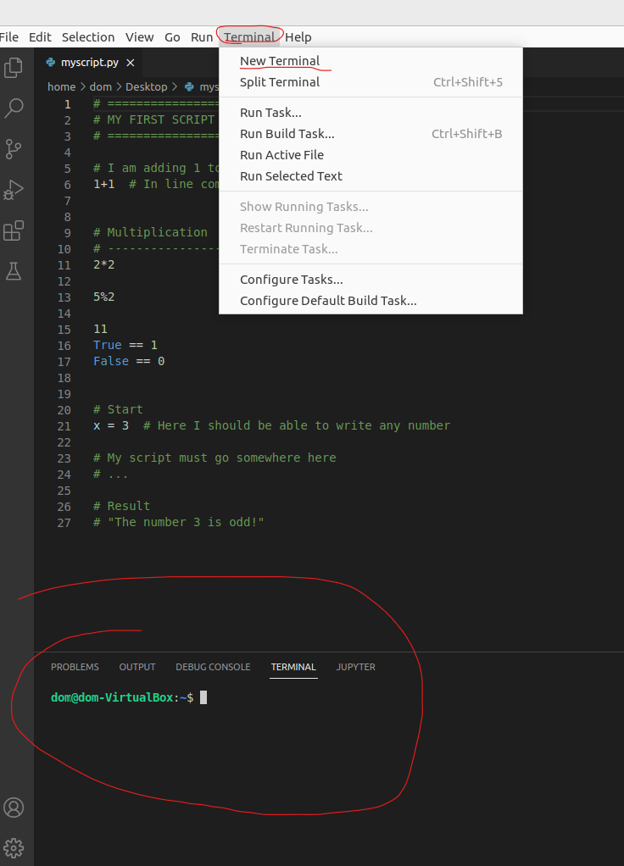
Basic Python
Installing packages
You don’t install Python packages from Python
Need to do it from the “terminal” using another package called “pip”
Installation instructions can be found usually on PyPI or GitHub
Install “black”
Google “black python package”
Find “pip” instructions

Slide 34
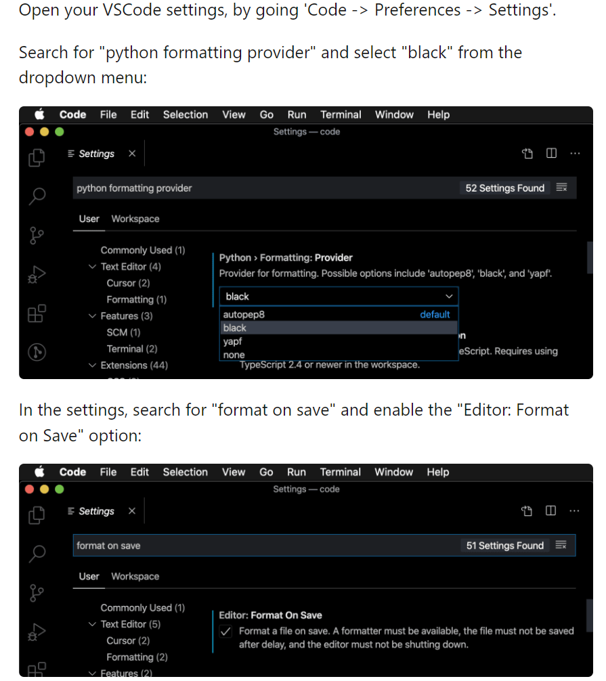
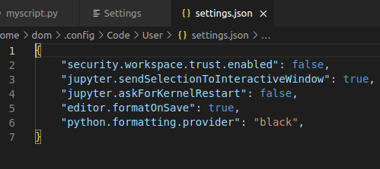
Basic Python
Autoformatting
Settings (UI)
Python formatting provided
“black”
Format on save

Slide 35
Exercice 9 💪 (5 min)
Goal: install packages:
numpy
scipy
matplotlib
pandas
statsmodels
scikit-learn
Successfully import them at the top of a file

Slide 36
Advanced Python

Slide 37
Exercice 10 💪 (5 min)
Goal: Create a function that takes a list of numbers and adds 1 to each number
Expected:
>>> addone([2, 4, 5, 6])
[3, 5, 6, 7]

Slide 38
Generation of numbers
np.arrange(10)
np.linspace(0, 9, 10)
np.random.normal(0, 1, 10)
Advanced Python
List comprehension
list1 = [1, 2, 3]
[l + 1 for l in list1]
Numpy
For math & matrix-operations
import numpy as np
Difference List vs. Array/Vector
Vector = vectorized operations
list2 = [2, 3, 4]
list1 + list2
Convert list into vector
x1 = np.array(list1)
x2 = np.array(list2)
x1 + x2
x1 + 2.5
x1**2

Slide 39
Exercice 11 💪 (5 min)
Goal: Create a function that adds 1, 2, …, i to a list
Expected:
>>> addrange([0, 0, 0, 0])
[1, 2, 3, 4]
>>> addrange([5, 6, 7, 8])
[6, 8, 10, 12]
Hint: use len(x) to get the length of a list/vector

Slide 40
Advanced Python
Conditional indexing
x = np.array([1, 2, 3, 4, 5])
x[::2]
idx = x <= 3
idx
x[idx]
x[idx] = -1
x

Slide 41
Advanced Python
Operations and math
np.sum(), np.mean(), np.median(), np.diff(), np.std()…
Function or method
np.sum() ⬄ x.sum()
Missing values
np.nan()
x = np.array([3, 5, np.nan, 3, 2])
np.mean(x)
# Solution 1: Filter out NaNs
np.isnan(x)
x[~np.isnan(x)].mean()
# Solution 2: Nan-friendly functions
np.nanmean(x)

Slide 42
Exercice 12 💪 (15 min)
Goal:
Create a function that takes a vector, and replaces values that are > or < 3*SD by NaN
Another function that returns a string with the mean, SD, and the number of outliers
Expected:
>>> drop_outlier([2, 4, 3, 1, 2, 54, 2, -42])
[2, 4, 3, 1, 2, np.nan, 2, np.nan]
>>> describe([2, 4, 3, 1, 2, np.nan, 2, np.nan])
“2.33 +- 0.94, 2 outliers”
Hint: np.round(x, 2)

Slide 43
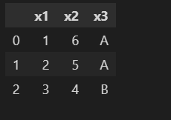
Advanced Python
Dataframes
Dataframes are “tables” (± 2D “matrix”)
Multiple types (difference with Arrays)
They have (named) columns and rows
Implemented in the pandas package
import pandas as pd
data = {"x1": [1, 2, 3], "x2": [6, 5, 4], "x3": ["A", "A", "B"]}
data = pd.DataFrame(data)
data
Select cols
data["x1"]
Note: returns a Series, can be converted to vector with data["x1"].values
data[["x1", "x2"]]

Slide 44
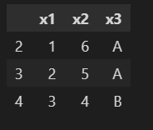
Advanced Python
Select rows (filtering)
Row names = index
Can be modified (or reset)
data.index = [2, 3, 4]
data
Need to “loc” (location) to filter
data.loc[data["x1"] >= 2]
data.loc[0:2]
Need to “iloc” (index-based location) to select by index
data.iloc[0:2]

Slide 45
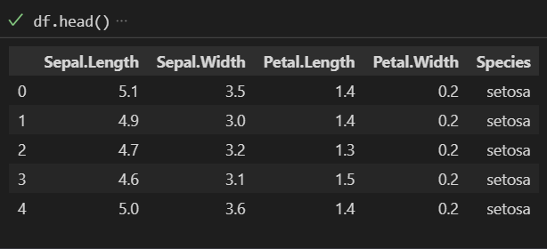
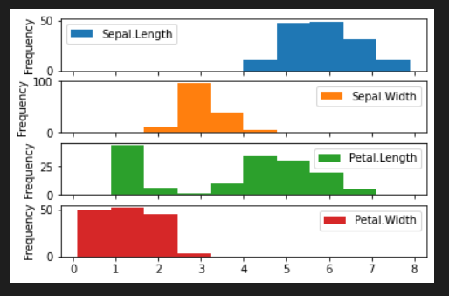
Advanced Python
Data Reading
https://github.com/DominiqueMakowski/teaching/blob/master/Python/2022_Zurich
Open “iris.csv”
Click “raw”
Right-click and download
df = pd.read_csv("iris.csv")
df.head()
df.describe()
df[“Species”].describe()
Plotting
df.plot.hist(subplots=True)
df.plot.scatter(x="Petal.Length", y="Sepal.Width")
Plotting uses matplotlib as a backend
A statistics-friendly alternative is seaborn

Slide 46
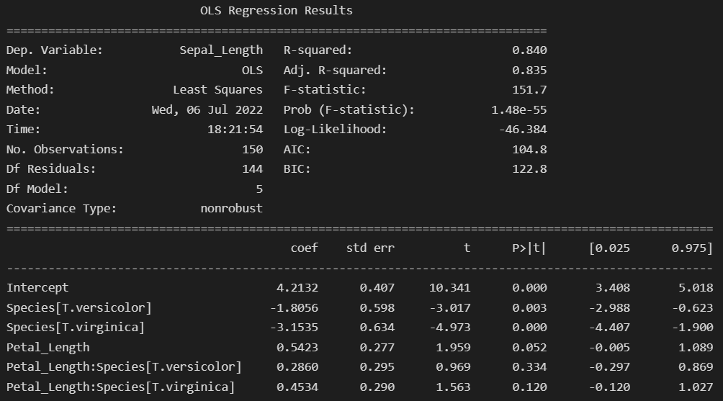
Advanced Python
Data science
scikit-learn (sklearn): machine-learning oriented
statsmodels: R-like approach
import statsmodels.api as sm
import statsmodels.formula.api as smf
df = pd.read_csv("iris.csv")
df.columns = [s.replace(".", "_") for s in df.columns]
results = smf.ols("Sepal_Length ~ Petal_Length * Species", data=df).fit()
print(results.summary())

Slide 47

Advanced Python
What to do from there?
Exploratory approach to Python: search, copy/paste & try
Goal-driven learning + community-based learning

Slide 48
GitHub

Slide 49
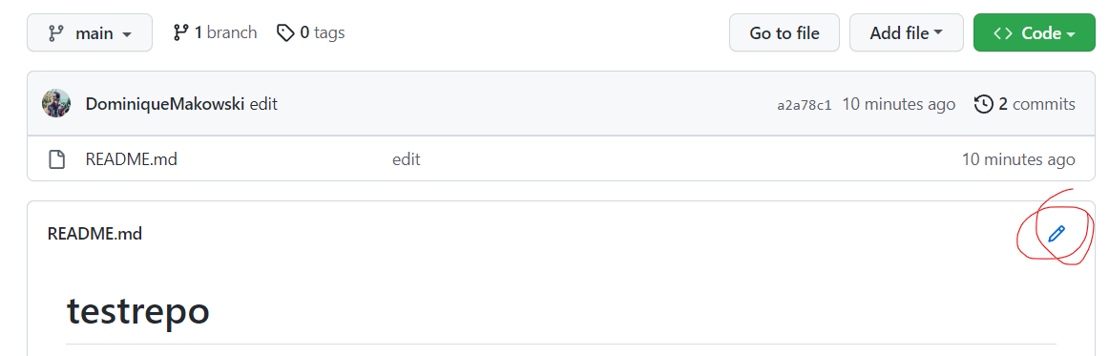
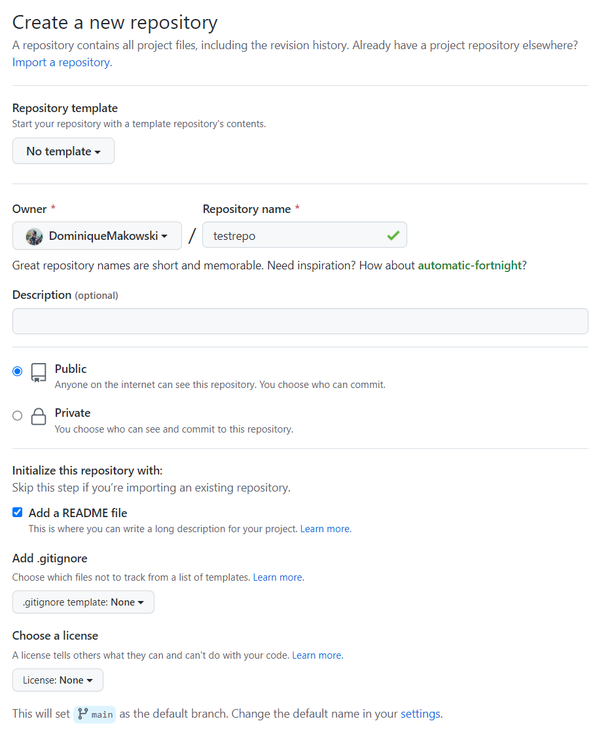
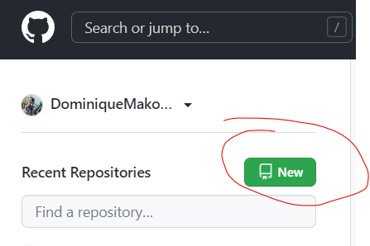
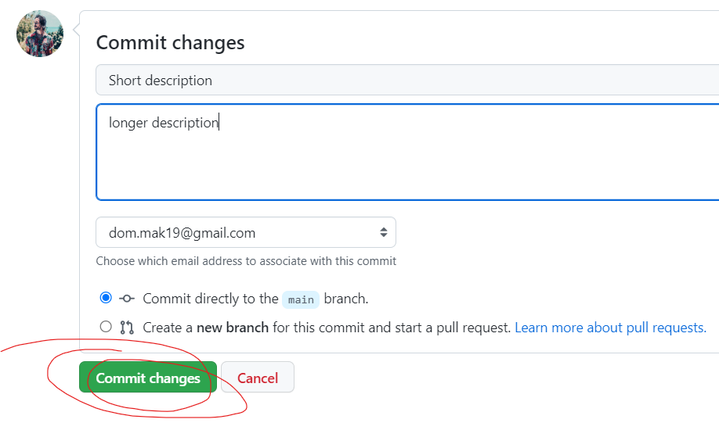
Exercice time 💪 (5 min)
Goal: Create and edit your own test repo
Create a new public repo called “testrepo” with a README file
Edit the file in the browser
Commit the change

Slide 50
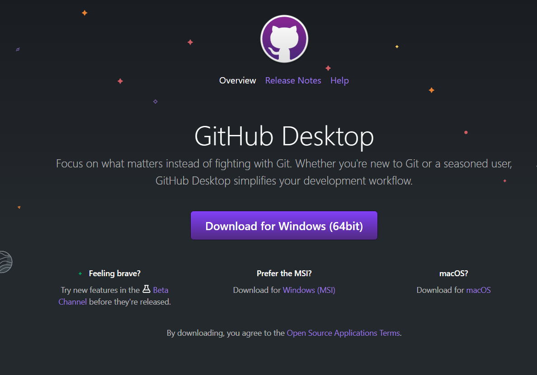
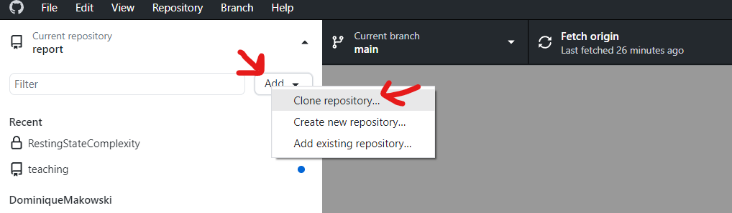
GitHub
Desktop GitHub
Install GitHub destop (https://desktop.github.com/)
Never use the git commands
Start and Sign in
You can “clone” a repo
= download it from GitHub.com to your machine locally
Go to “Clone Repository”

Slide 51
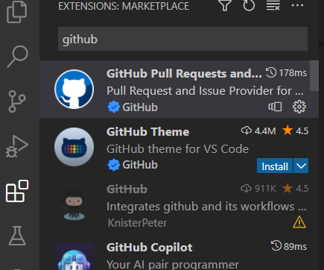
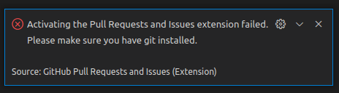
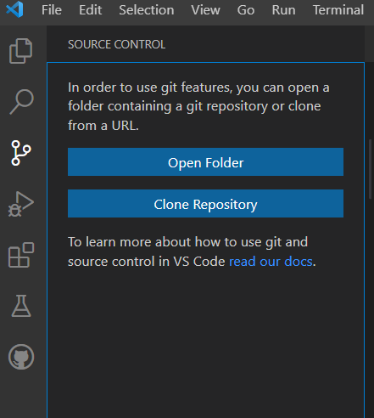
GitHub
GitHub on VScode
Install git (https://git-scm.com/download)
GitHub Pull Requests and Issues
Go to “Clone Repository” (clone from GitHub)
Sign in
GitHub locally:
You can “clone” a repo
= download it from GitHub to your machine locally

Slide 52
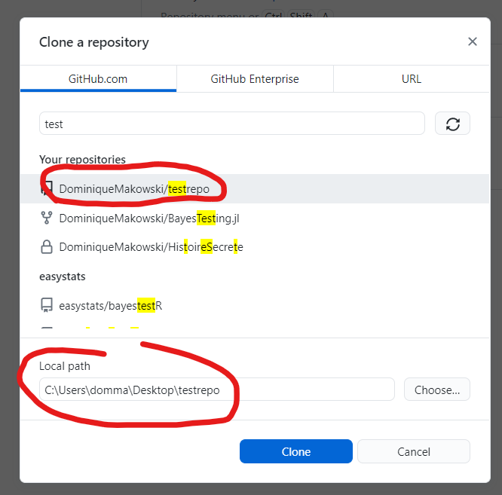
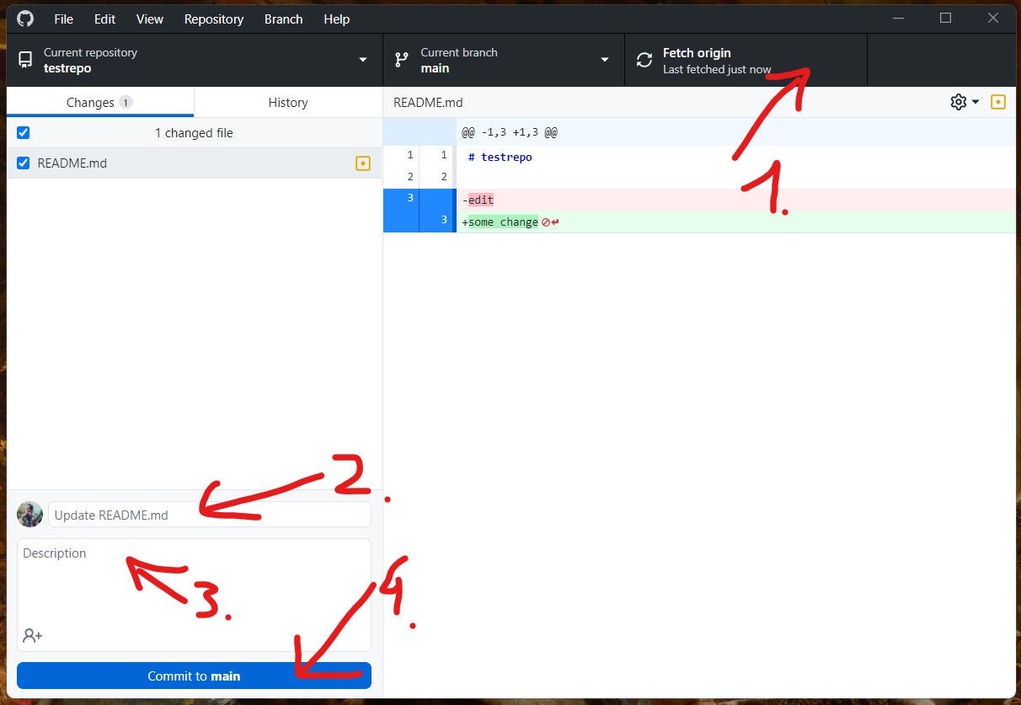
Exercice time 💪 (5 min)
Goal: Create, clone and edit your own test repo
Clone your “testrepo” locally, and save it somewhere (e.g., desktop)
Open the folder
Edit the README.md locally (e.g., with VS code)
Commit (= record the changes)
Push (upload to GitHub.com)

Slide 53
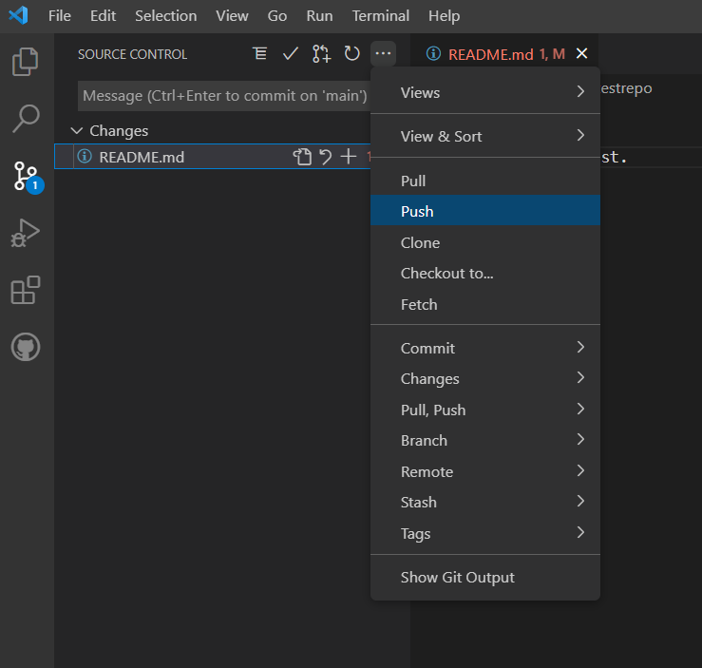
Exercice time 💪 (2 min)
Goal: Create, clone and edit your own test repo
Create a new repo called “testrepo” with a README file
Clone it from VS code, and save it somewhere (e.g., desktop)
Open the folder in Vscode
Edit the README locally
Commit

Slide 54
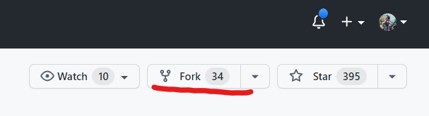
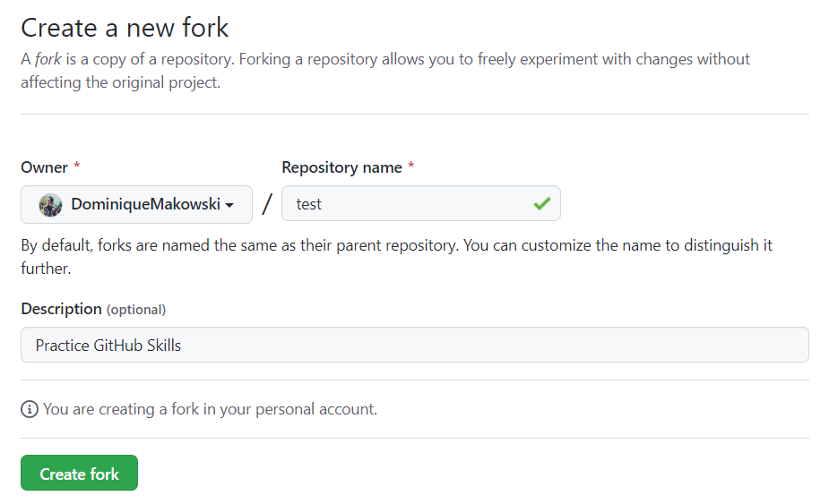
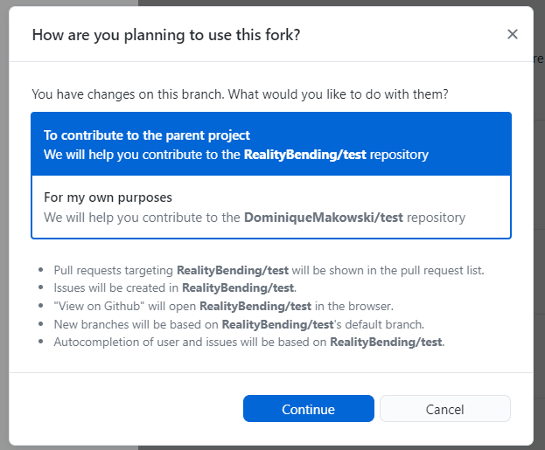
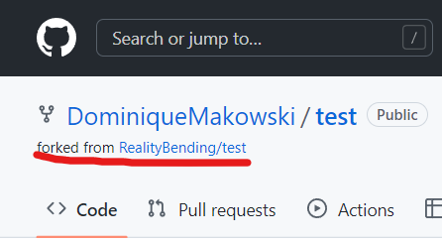
GitHub
Cannot do “direct push” on repos that are not yours
Need to create a Pull Request (PR)
Forking:
If repo is not yours, you first “fork” it
(copy and create your own personal version)

Slide 55
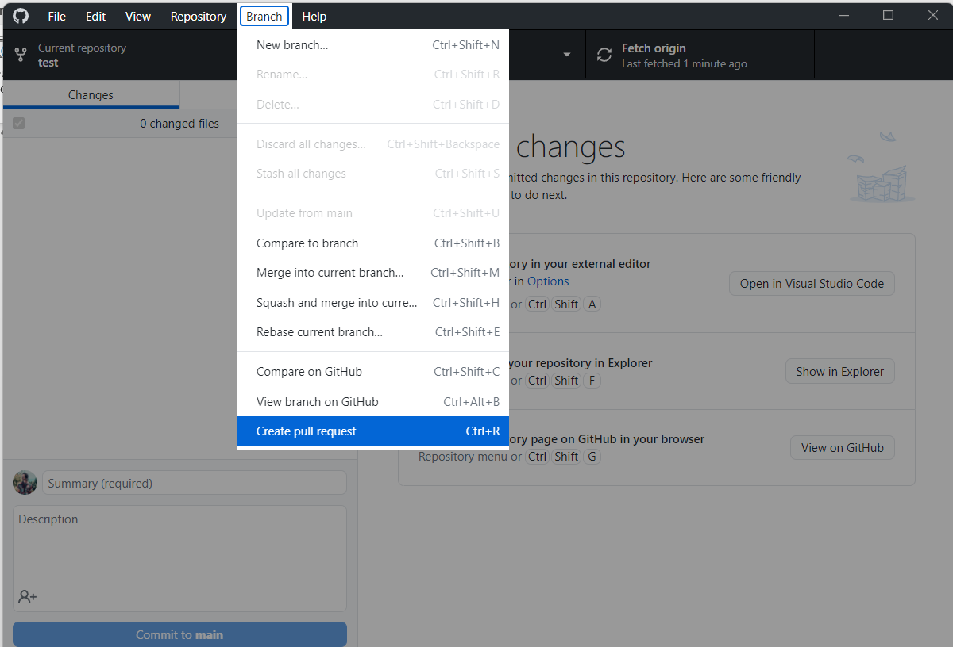
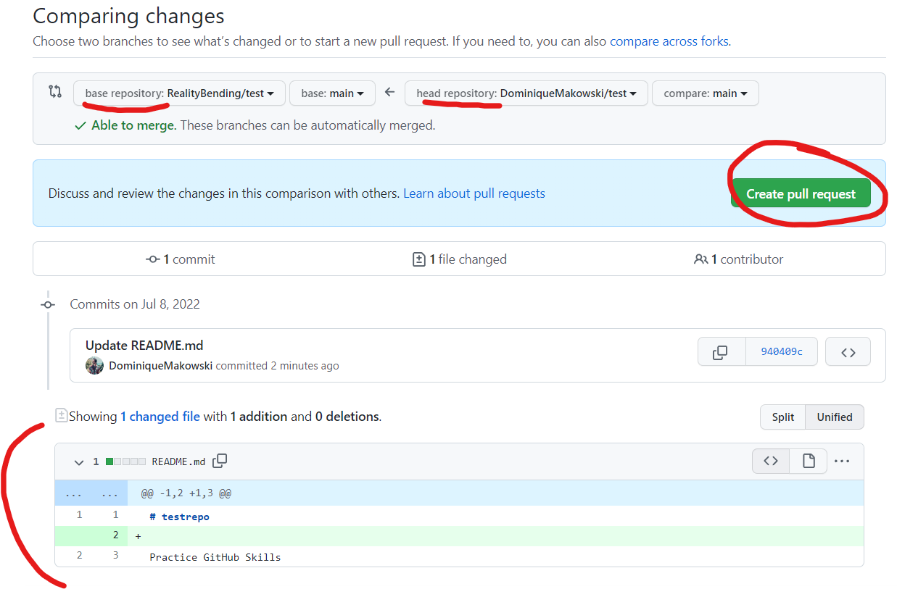
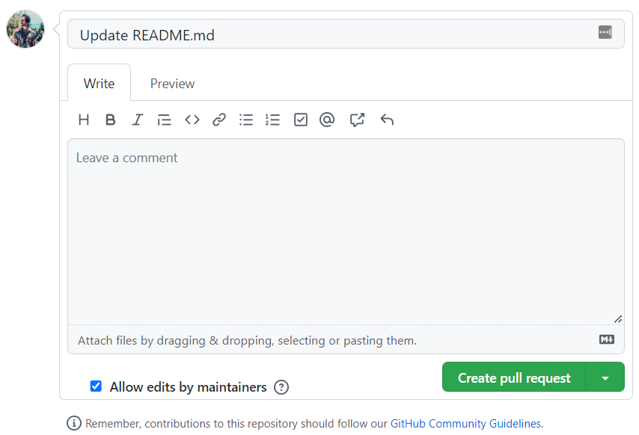
GitHub
Pull Request (PR):
Clone the forked repo locally
Make changes
Commit & push (= to your own fork)
Your fork becomes “ahead” of the base repo
Branch -> create Pull Request -> Github
Verify the branches and changes
Add a title and some comments
Create PR

Slide 56
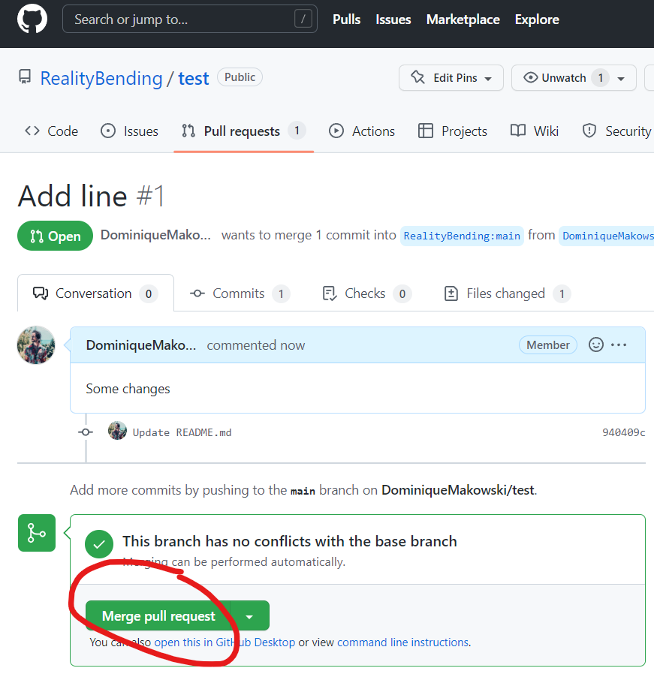
GitHub
Merging Pull Request (PR):
The owner can then review, comment
And merge the PR
Congrats 🥳 you have become a contributor
Watch the demo

Slide 57
Goal: Create a Pull Request (PR):
Fork /DominiqueMakowski/teaching
Clone it locally
Delete the line that is assigned to you
Make a PR
Exercice time 💪 (10 min)

Slide 58
Goal: Create another Pull Request (PR):
Add something to the README of the testrepo of another person
Jasmin -> Rebecca C. -> Rebecca J. -> Pascal -> Sven -> Zita -> Carlo -> Flora -> Martyna -> Nathalie -> Ana Elisa -> Lena -> Georgia ->
Breakout rooms for mutual help
Exercice time 💪 (15 min)

Slide 59
Jupyter notebooks

Slide 60
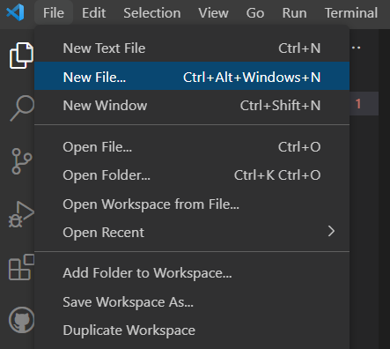
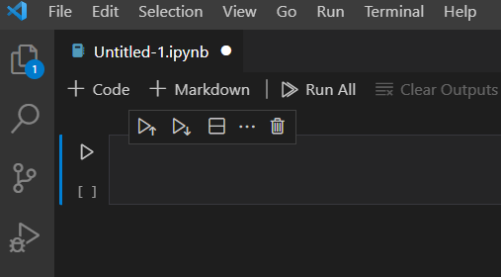
Jupyter
Create notebook:
New file -> Notebok (*.ipynb)
Notebooks mix cells with text (in markdown) with code

Slide 61
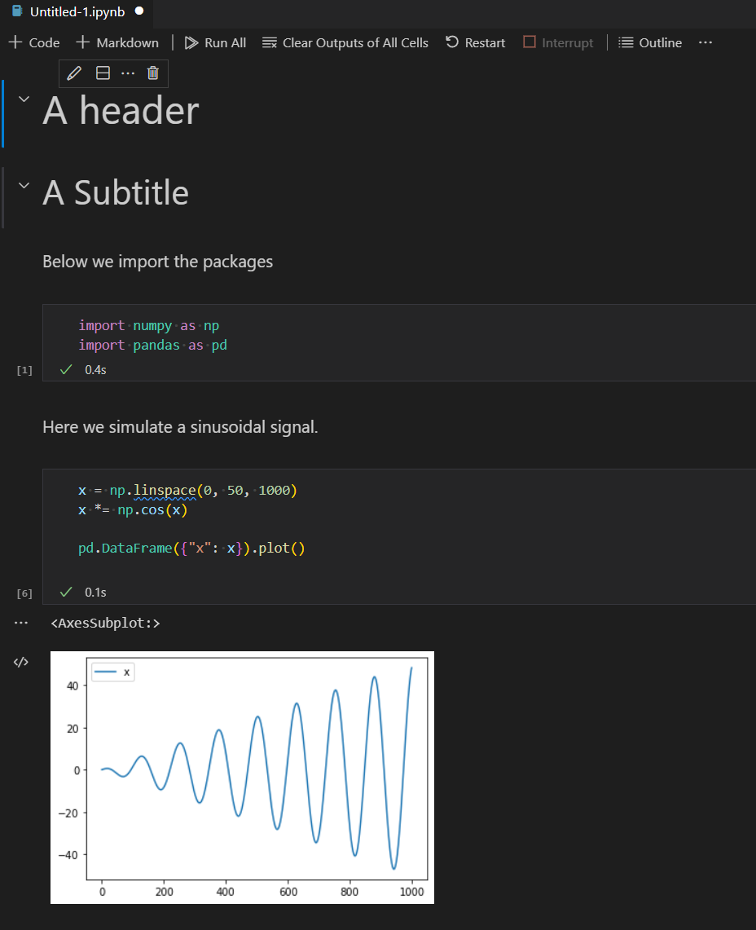
Goal:
Reproduce this notebook
Save it in your testrepo
Push it to GitHub
See how it renders on GH
Exercice time 💪 (10 min)

Slide 62
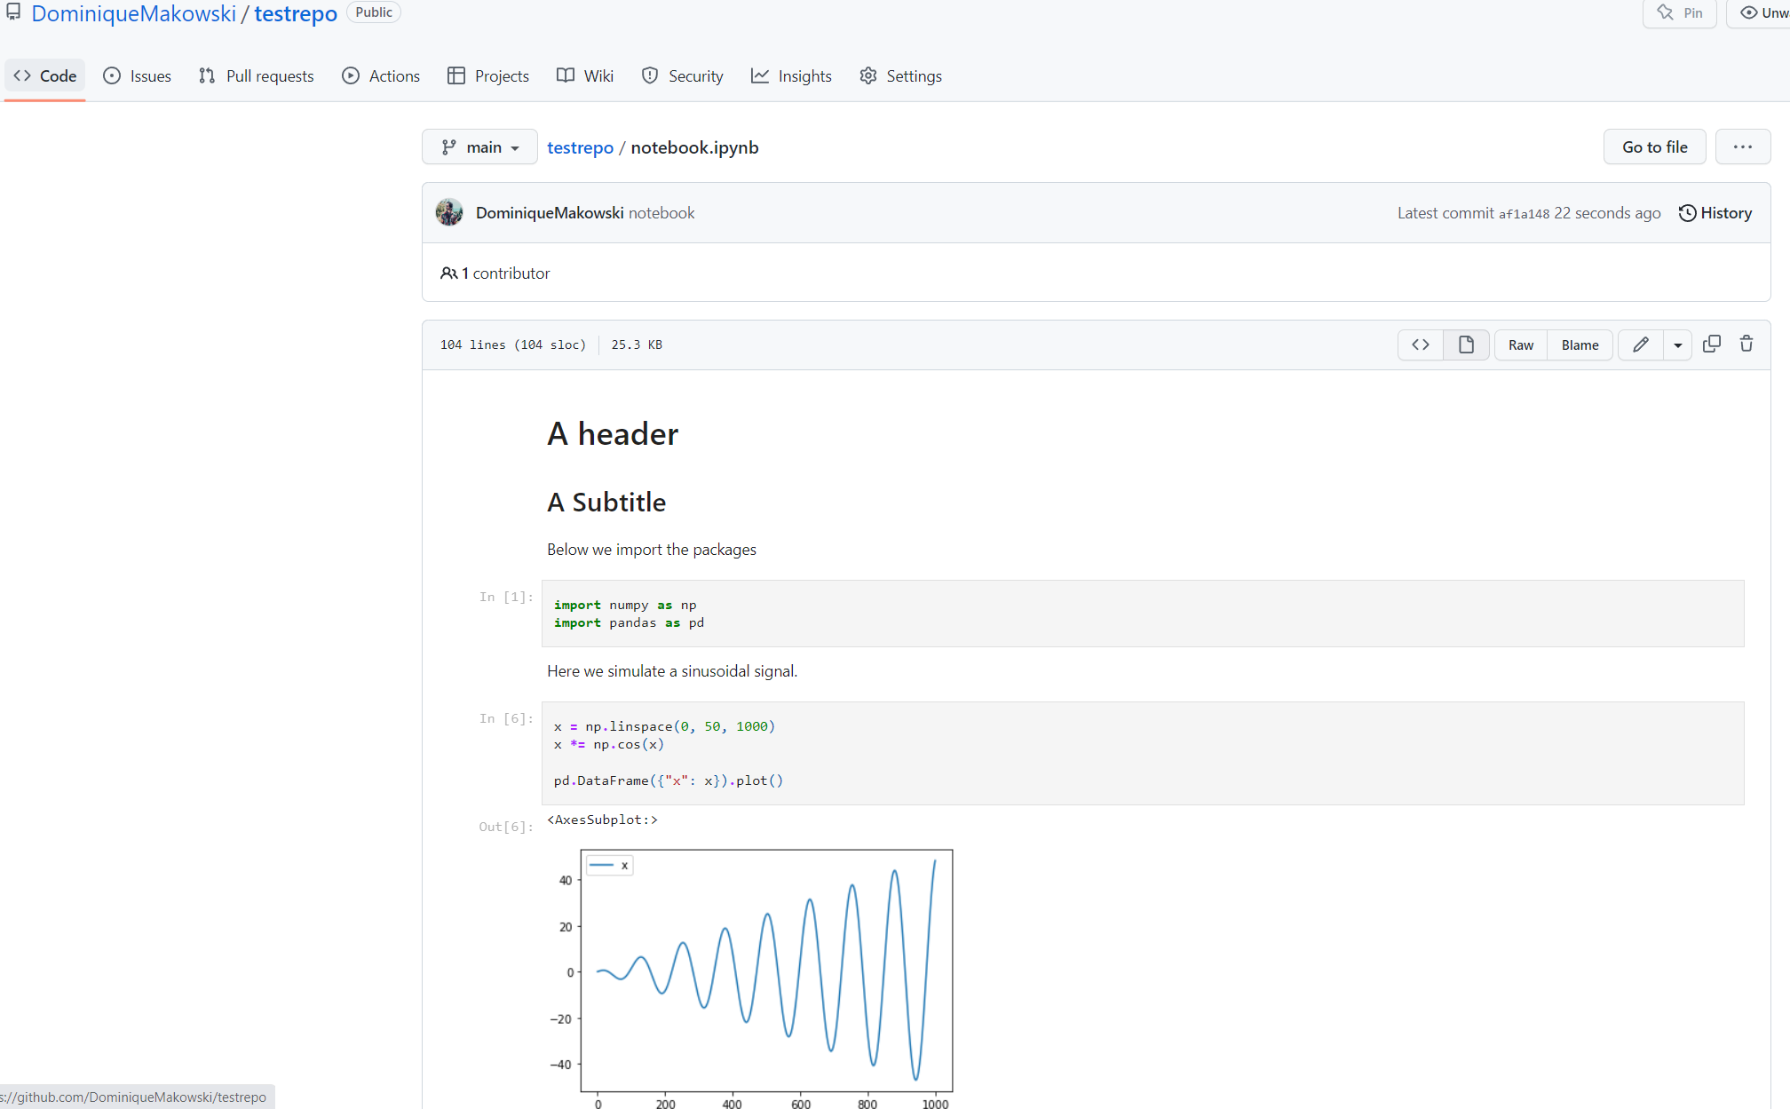

Slide 63
Jupyter
Notebooks can be great to communicate data analysis results, or for tutorials / examples
Some people use them exclusively, but harder to make easily re-usable code

Slide 64
Signal Processing

Slide 65

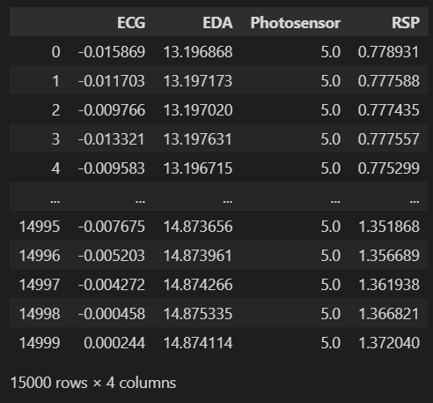
Signal Processing
install “neurokit2” (pip install neurokit2)
Download example data
data = nk.data("bio_eventrelated_100hz")
data
Sampling rate = number of data points (samples) per second (in Hertz)
What’s the duration of the recording?

Slide 66
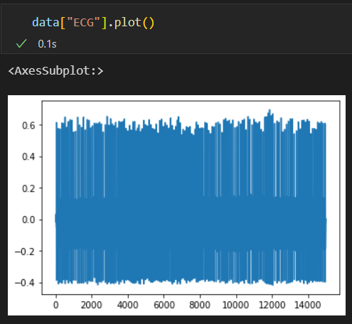
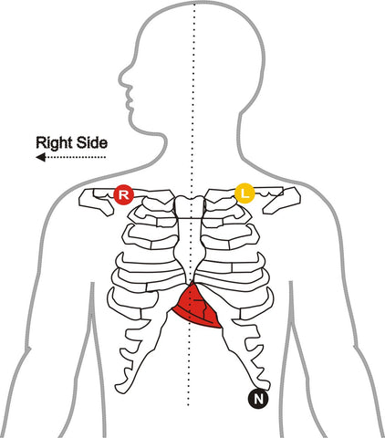


ECG
Visualize the ECG column
Visualize a subset
Signal Processing

Slide 67


ECG
Clean the signal (filter to remove noise)
Specify sampling_rate
Detect R-peaks
Extract peak location
Signal Processing

Slide 68

ECG
Compute rate
Specify desired_length
Visualize
Compute mean
Signal Processing

Slide 69
Goal:
Compute heart rate
Save it in your testrepo
Push it to GitHub
See how it renders on GH
Exercice time 💪 (10 min)

Slide 70
Packaging

